Slide 1
Department of CSE
COURSE NAME: Data science
COURSE CODE: 24AD3107
Topic:
Heat Maps and Corelation Analysis
Session - 8

Slide 2
AIM OF THE SESSION
To familiarize students with the basic concepts of Heat Maps and Corelation Analysis.
INSTRUCTIONAL OBJECTIVES
This Session is designed to: Introduction to Heat Maps and Corelation Analysis.
LEARNING OUTCOMES
At the end of this session, you should be able to: have knowledge on Heat Maps and Corelation Analysis between the features in a data set

Slide 3
Key Concepts
SESSION INTRODUCTION
Introduction to HeatMaps
Corelation analysis

Slide 4
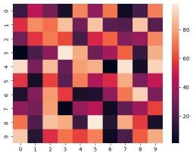
Seaborn Heatmap
A heatmap is a graphical representation of data where individual values are represented by color intensity. It is widely used in data analysis and visualization to identify patterns, correlations and trends within a dataset. Heatmaps in Seaborn can be plotted using the seaborn.heatmap() function, which offers extensive customization options.
import numpy as np
import seaborn as sns
import matplotlib.pyplot as plt
# Generating a 10x10 matrix of random numbers
data = np.random.randint(1, 100, (10, 10))
sns.heatmap(data)
plt.show()
This will produce a heatmap where the intensity of color represents the magnitude of values in the matrix.

Slide 5
Syntax of seaborn.heatmap()
seaborn.heatmap(data, *, vmin=None, vmax=None, cmap=None, center=None, annot_kws=None, linewidths=0, linecolor='white', cbar=True, **kwargs)
Parameters:
data: A 2D dataset that can be coerced into a NumPy ndarray.
vmin, vmax: Values to anchor the colormap; if not specified, they are inferred from the data.
cmap: The colormap for mapping data values to colors.
center: Value at which to center the colormap when plotting divergent data.
annot: If True, displays numerical values inside the cells.
fmt: String format for annotations.
linewidths: Width of the lines separating cells.
linecolor: Color of the separating lines.
cbar: Whether to display a color bar.
Note: All parameters except data are optional.
Returns: returns an object of type matplotlib.axes.Axes

Slide 6
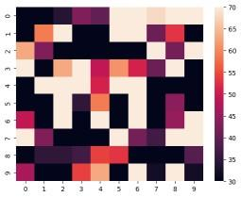
Example 1: By setting vmin and vmax, we explicitly define the range of values that influence the color scaling in the heatmap. This ensures consistency across multiple heatmaps, preventing extreme values from distorting the visualization.
import numpy as np
import seaborn as sns
import matplotlib.pyplot as plt
data = np.random.randint(1, 100, (10, 10))
sns.heatmap(data, vmin=30, vmax=70)
plt.show()
The parameters vmin=30 and vmax=70 define the limits of the color scale range. Values lower than 30 are represented by the lowest intensity color, while values higher than 70 are mapped to the highest intensity color.

Slide 7
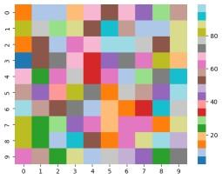
Example 2:The cmap parameter allows us to modify the color scheme of the heatmap, improving its visual appeal and making it easier to distinguish between different values.
import numpy as np
import seaborn as sns
import matplotlib.pyplot as plt
data = np.random.randint(1, 100, (10, 10))
sns.heatmap(data, cmap='tab20')
plt.show()
The argument cmap='tab20' sets a categorical colormap. Sequential colormaps (Blues, Reds, Greens) suit continuous data, while diverging colormaps (coolwarm, RdBu) highlight variations.

Slide 8
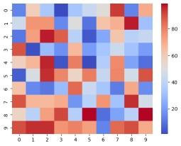
Example 3: By setting the center parameter, we ensure that a specific value (such as the mean or median) appears neutral in the colormap. This adjustment makes deviations above and below this value more distinguishable.
import numpy as np
import seaborn as sns
import matplotlib.pyplot as plt
data = np.random.randint(1, 100, (10, 10))
sns.heatmap(data, cmap='coolwarm', center=50)
plt.show()
The center=50 parameter sets 50 as a neutral color. Values above it are shaded in one color (e.g., red) and below in another (e.g., blue), making it useful for highlighting deviations from a reference point.

Slide 9
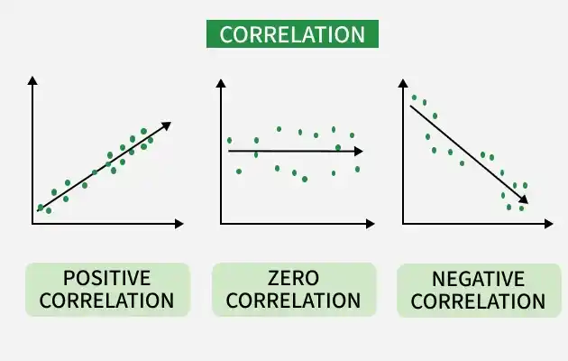
Corelation:
Correlation is one of the most commonly used statistical measures to understand how variables are related to each other. In Python, correlation helps identify whether two variables move together, move in opposite directions or have no relationship at all.
Helps understand data relationships.
Useful in feature selection for ML models.
Detects multicollinearity.
Supports better decision-making.

Slide 10
Correlation measures the strength and direction of the relationship between two numerical variables. Value ranges from -1 to +1
+1: Perfect positive relationship. That means both variables increase or decrease together. Example: Height and weight
-1: Perfect negative relationship meaning one variable increases while the other decreases. Example: Price and demand
0: No relationship or no correlation means no visible relationship between variables. Example: Shoe size and exam marks
Common Correlation Methods in Python
1. Pearson Correlation
Pearson Correlation measures linear relationship between two continuous variables.
Range: -1 to +1
Assumes normally distributed data
2. Spearman Correlation
Spearman Correlation measures monotonic relationship using ranks.
Works with non-linear data
Suitable for ordinal data
3. Kendall Correlation
Kendall Correlation measures rank consistency between variables.
More robust for small datasets

Slide 11
Syntax:
var = df.corr(method='pearson’) #here method may be any one of corelations in python
print(var)
Limitations of Correlation
Only measures association
Sensitive to outliers
Applications of Correlation
Feature selection in machine learning
Financial market analysis
Medical research
Recommendation systems

Slide 12
Interpreting Correlation Values
Correlation Value | Meaning
0.8 to 1.0 | Strong positive
0.5 to 0.8 | Moderate positive
0.0 to 0.5 | Weak positive
0 | No correlation
-0.5 to 0 | Weak negative
-0.8 to -0.5 | Moderate negative
-1.0 to -0.8 | Strong negative

Slide 13
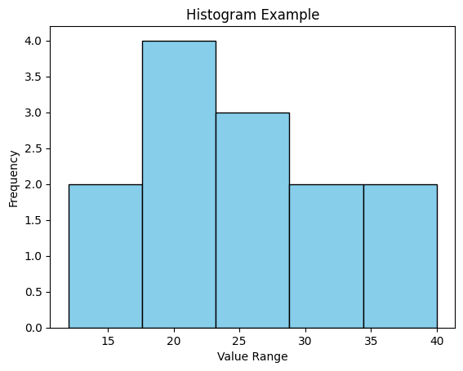
data: your dataset (list, NumPy array, etc.)
bins: number of intervals (e.g., 5 bins)
color & edgecolor: styling options
Histograms:
n Python, histograms are a powerful way to visualize the distribution of data. They group values into bins and show how many data points fall into each bin.
import matplotlib.pyplot as plt
data = [12, 15, 20, 20, 22, 23, 25, 25, 25, 30, 32, 35, 40]
plt.hist(data, bins=5, color='skyblue', edgecolor='black')
plt.title("Histogram Example")
plt.xlabel("Value Range")
plt.ylabel("Frequency")
plt.show()
data: your dataset (list, NumPy array, etc.)
bins: number of intervals (e.g., 5 bins)
color & edgecolor: styling options

Slide 14
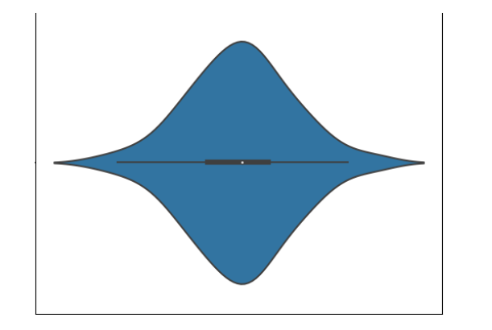
Violin Plot:
Violin plots are a combination of box plot and histograms. It portrays the distribution, median, interquartile range of data. So we see that IQR and median are the statistical information provided by box plot whereas distribution is being provided by the histogram.

Slide 15
The white dot refers to the median.
The end points of the bold line represent the iqr1 and iqr3.
The end points of the thin line represent the min and max similar to the box plot.
The distribution above 1.5x interquartile(min, max end points of the thin line) denotes the presence of outliers.
Syntax: violinplot(dataset, positions=None, vert=True, widths=0.5, showmeans=False, showextrema=True, showmedians=False, quantiles=None, points=100,
bw_method=None, *, data=None)

Slide 16
REFERENCES FOR FURTHER LEARNING OF THE SESSION
Text Books:
Introduction to Data Science- A Structured Methodology,Goran trajkovski.
Data Science from Scratch- Joel Grus - O’Reilly - 2015
Practical Statistics for Data Scientists - Peter Bruce, Andrew Bruce & Peter Gedeck - O’Reilly - 2020
Data Science and Machine Learning (Mathematical and Statistical Methods) - Dirk P. Kroese, Zdravko I. Botev, Thomas Taimre, Radislav Vaisman- Chapman and Hall/CRC - 2025
Foundations of Data Science - Avrim Blum, John Hopcroft, and Ravindran Kannan - Cambridge University Press – 2020
Reference Books:
R1.Data Science and Its Applications by Aakanksha Sharaff and G. R. Sinha.
R2. Introducing Data Science Big Data, Machine Learning, and more using Python tools. by Davy cielen, Arno D.B. Meysman and Mohamed Ali.

Slide 17

THANK YOU
Team – DS

